Slide 1
CE3002: Sensors, Interfacing and Control
Lab Project Briefing
Supervisor:
Asst/P Mahardhika Pratama (mpratama@ntu.edu.sg)
Dr. Smitha K G(smitha@ntu.edu.sg)

Slide 2
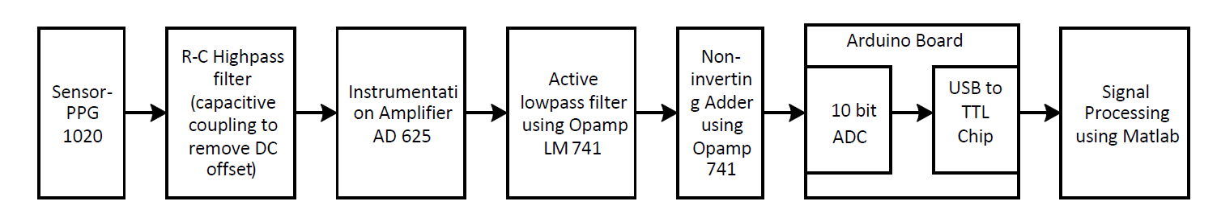
Objective
Design & Implementation of a PC-based Infrared Plethysmograph(PPG) for measurement and analysis of blood volume changes.

Slide 3
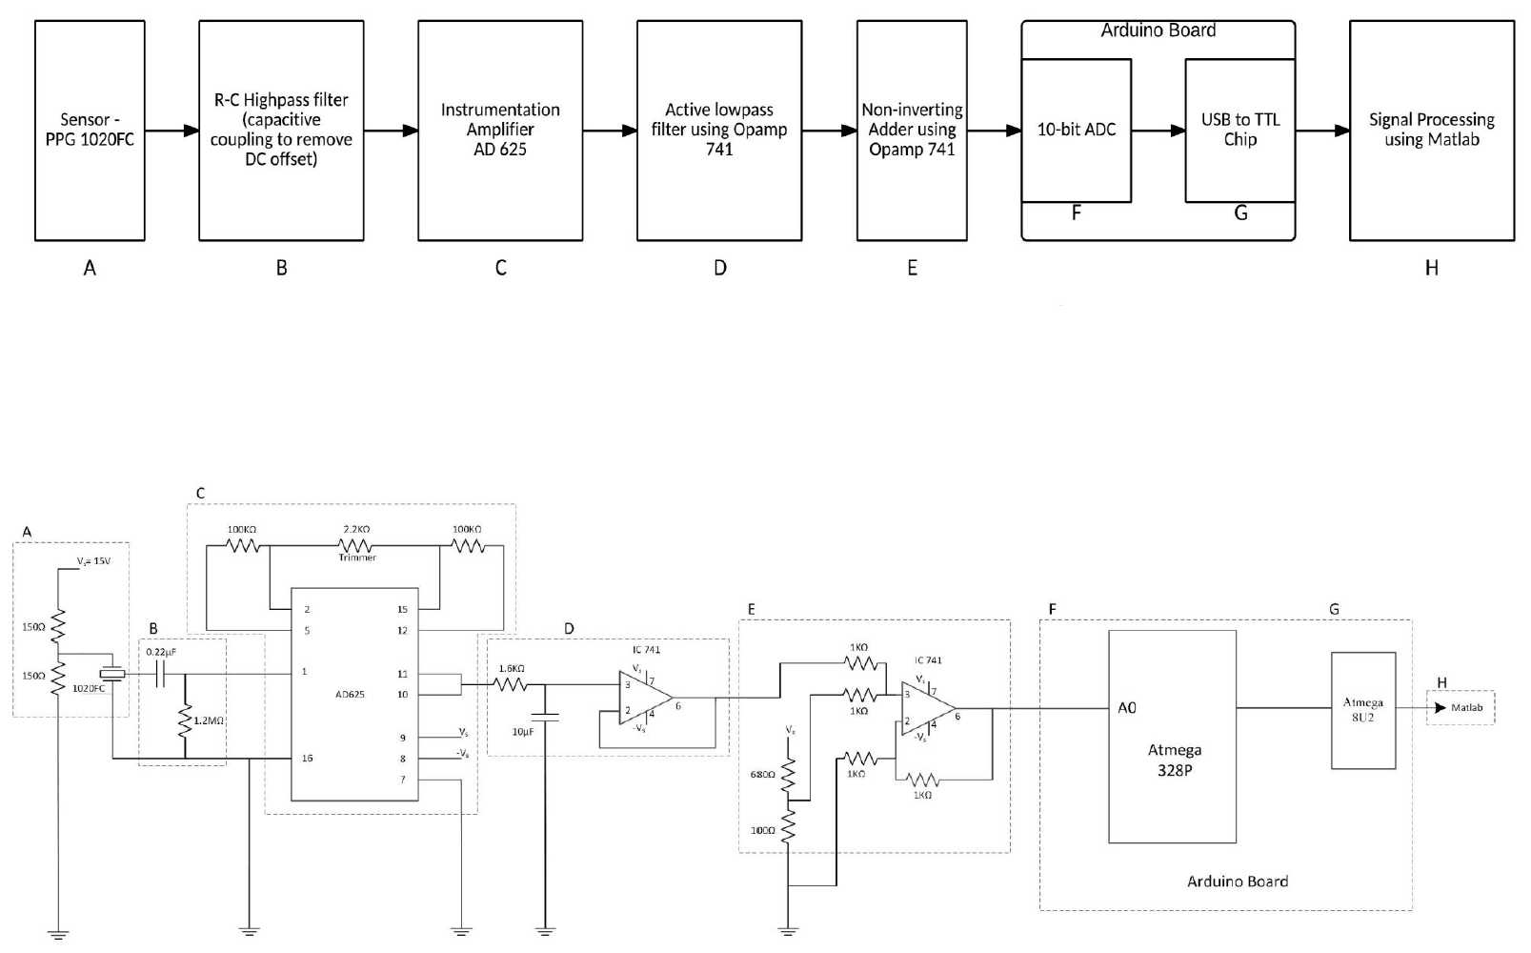
Circuit Diagram

Slide 4
Resources
Hardware Kit
Power supply (+15V & -15V)
Oscilloscope
Signal generator
Lab manual
Useful notes
Code
Arduino
MATLAB

Slide 5
Suggestion and notes
Use signal generator to test your circuit
The PPG sensor sometimes has uncertainty
20mV (peak-to-peak), sine wave, 500mHz
Well keep the hardware components
PPG sensor expensive
Restore if lost

Slide 6
7.5 V DC

Slide 7
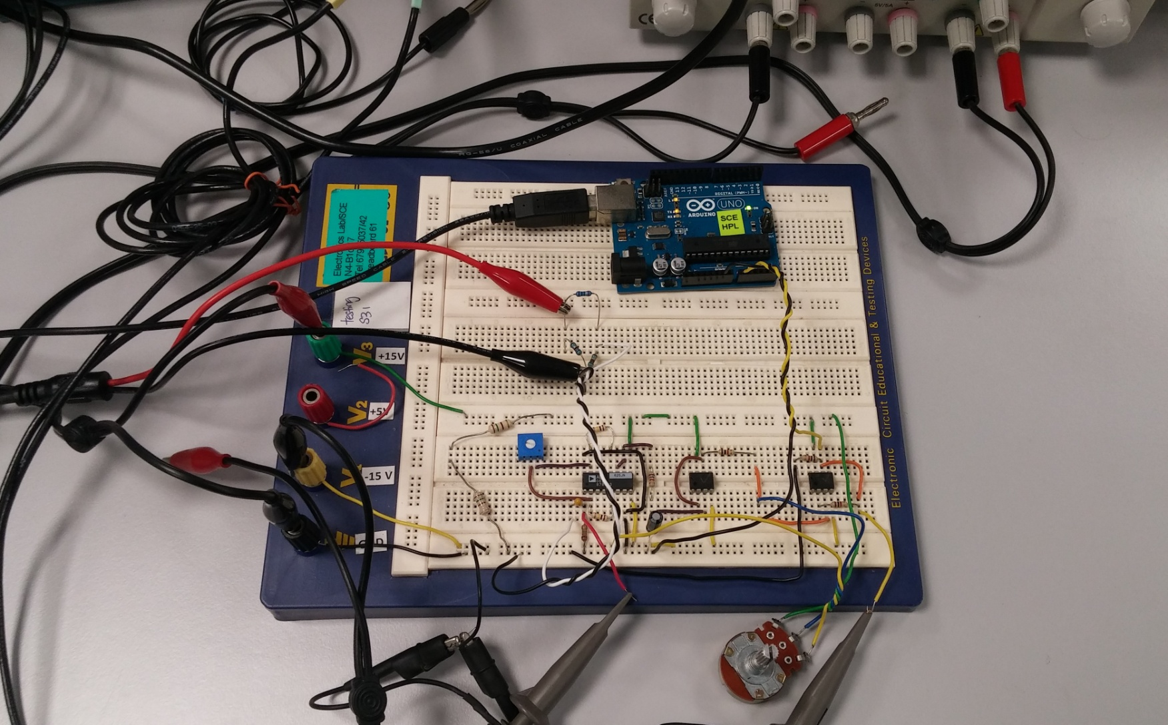
A completed sample

Slide 8
Evaluation
Demo (60% - common score for a team)
Basic functionality (40%)
Major component (e.g., amp) missed: 0 points
Partially functioning with small issues: 20 points
Fully functioning: 40 points
Additional features (20%)
E.g., real-time pulse rate, weak signal alert, etc
Oral (40% - individual scores for team members)
State your contribution
Q/A

Slide 9
Evaluation (cont’d)
Final evaluation in the last lab session
Week 12 for TE1, SE2
Week 11 for TE2, TE3, SE1, SE3
10% bonus marks, if the project is ready for evaluation by
Week 10 for TE1, SE2
Week 9 for TE2, TE3, SE1, SE3

